Slide 1

课程尚未开始
请大家耐心等待
关注微信公共账号，获得最新面试题信息及解答
Facebook: http://www.facebook.com/ninechapter
Weibo:
http://www.weibo.com/ninechapter
Renren:
http://page.renren.com/601712402

Slide 2
Number Triangle
http://www.lintcode.com/zh-cn/problem/number-triangle/
http://www.ninechapter.com/solutions/triangle/

Slide 3
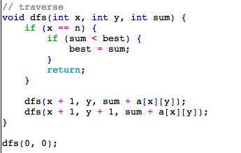
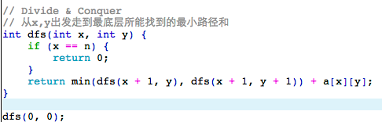
DFS

Slide 4
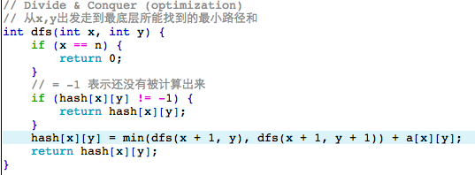
DFS Optimization

Slide 5
记忆化搜索
本质上：动态规划
动态规划就是解决了重复计算的搜索
动态规划的实现方式：
1. 记忆化搜索
2. 循环

Slide 6
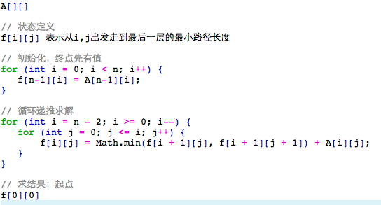
自底向上的动态规划

Slide 7
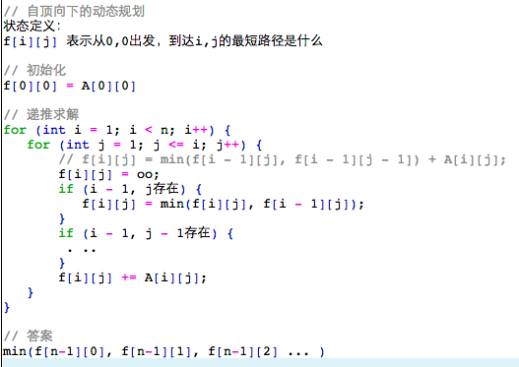
自顶向下的动态规划

Slide 8
动态规划的4点要素
1. 状态 State
灵感，创造力，存储小规模问题的结果
2. 方程 Function
状态之间的联系，怎么通过小的状态，来算大的状态
3. 初始化 Intialization
最极限的小状态是什么, 起点
4. 答案 Answer
最大的那个状态是什么，终点

Slide 9
如何想到使用DP
1. One of the following three
a) Maximum/Minimum
b) Yes/No
c) Count all possbile solutions
2. Can not sort / swap
https://oj.leetcode.com/problems/longest-consecutive-sequence/

Slide 10
面试最常见的四种类型
1. Matrix DP (10%)
2. Sequence (40%)
3. Two Sequences DP (40%)
*4. Backpack (10%)

Slide 11
5 minutes break

Slide 12
1. Matrix DP
state: f[x][y] 表示我从起点走到坐标x,y……
function: 研究最后一步怎么走
intialize: 起点
answer: 终点

Slide 13
Unique Paths
http://www.lintcode.com/zh-cn/problem/unique-paths/
http://www.ninechapter.com/solutions/unique-paths/

Slide 14
Unique Paths
state: f[x][y]从起点到x,y的路径数
function: (研究倒数第一步)
f[x][y] = f[x - 1][y] + f[x][y - 1]
intialize: f[0][0] = 1
// f[0][i] = 1, f[i][0] = 1
answer: f[n-1][m-1]

Slide 15
Unique Paths II
http://www.lintcode.com/zh-cn/problem/unique-paths-ii/
http://www.ninechapter.com/solutions/unique-paths-ii/

Slide 16
Minimum Path Sum
http://www.lintcode.com/zh-cn/problem/minimum-path-sum/
http://www.ninechapter.com/solutions/minimum-path-sum/

Slide 17
Minimum Path Sum
state: f[x][y]从起点走到x,y的最短路径
function: f[x][y] = min(f[x-1][y], f[x][y-1]) + cost[x][y]
intialize: f[0][0] = cost[0][0]
// f[i][0] = sum(0,0 -> i,0)
// f[0][i] = sum(0,0 -> 0,i)
answer: f[n-1][m-1]

Slide 18
2. Sequence Dp
state: f[i]表示“前i”个位置/数字/字母,(以第i个为)...
function: f[i] = f[j] … j 是i之前的一个位置
intialize: f[0]..
answer: f[n-1]..

Slide 19
Climbing Stairs
http://www.lintcode.com/zh-cn/problem/climbing-stairs/
http://www.ninechapter.com/solutions/climbing-stairs/

Slide 20
Climbing Stairs
state: f[i]表示前i个位置，跳到第i个位置的方案总数
function: f[i] = f[i-1] + f[i-2]
intialize: f[0] = 1
answer: f[n]

Slide 21
Jump Game
http://www.lintcode.com/zh-cn/problem/jump-game/
http://www.ninechapter.com/solutions/jump-game/

Slide 22
Jump game
state: f[i]代表我能否跳到第i个位置
function: f[i] = OR(f[j], j < i && j能够跳到i)
initialize: f[0] = true;
answer: f[n-1]

Slide 23
Jump Game II
http://www.lintcode.com/zh-cn/problem/jump-game-ii/
http://www.ninechapter.com/solutions/jump-game-ii/

Slide 24
Jump game II
state: f[i]代表我跳到这个位置最少需要几步
function: f[i] = MIN(f[j]+1, j < i && j能够跳到i)
initialize: f[0] = 0;
answer: f[n-1]

Slide 25
Palindrome Partitioning II
http://www.lintcode.com/zh-cn/problem/palindrome-partitioning-ii/
http://www.ninechapter.com/solutions/palindrome-partitioning-ii/

Slide 26
Palindrome Partitioning ii
state: f[i]”前i”个字符组成的字符串需要最少几次cut
function: f[i] = MIN(f[j]+1, j < i && j+1 ~ i这一段是一个回文串)
intialize: f[i] = i - 1 (f[0] = -1)
answer: f[s.length()]

Slide 27
Word Segmentation
http://www.lintcode.com/zh-cn/problem/word-segmentation/
http://www.ninechapter.com/solutions/word-break/

Slide 28
Word Segmentation
state: f[i]表示前i个字符能否被完美切分
function: f[i] = OR(f[j], j < i, j+1 ~ i是一个词典中的单词)
intialize: f[0] = true
answer: f[s.length()]
注意：切分位置的枚举->单词长度枚举
O(NL), N: 字符串长度, L: 最长的单词的长度

Slide 29
Longest Increasing Subsequence
http://www.lintcode.com/zh-cn/problem/longest-increasing-subsequence/
http://www.ninechapter.com/solutions/longest-increasing-subsequence/

Slide 30
Longest Increasing Subsequence
state:
错误的方法: f[i]表示前i个数字中最长的LIS的长度
正确的方法: f[i]表示前i个数字中以第i个结尾的LIS的长度
function: f[i] = MAX(f[j]+1, j < i && a[j] <= a[i])
intialize: f[0..n-1] = 1
answer: max(f[0..n-1])

Slide 31
LIS 贪心反例
1 1000 2 3 4
10 11 12 1 2 3 4 13

Slide 32
3. Two Sequences Dp
state: f[i][j]代表了第一个sequence的前i个数字/字符 配上第二个sequence的前j个...
function: f[i][j] = 研究第i个和第j个的匹配关系
intialize: f[i][0] 和 f[0][i]
answer: f[s1.length()][s2.length()]

Slide 33
Longest Common Subsequence
http://www.lintcode.com/en/problem/longest-common-subsequence/
http://www.ninechapter.com/solutions/longest-common-subsequence/

Slide 34
Longest Common Subsequence
state: f[i][j]表示前i个字符配上前j个字符的LCS的长度
function: f[i][j] = f[i-1][j-1] + 1 // a[i] == b[j]
= MAX(f[i-1][j], f[i][j-1]) // a[i] != b[j]
intialize: f[i][0] = 0
f[0][j] = 0
answer: f[a.length()][b.length()]

Slide 35
Longest Common Substring
http://www.lintcode.com/en/problem/longest-common-substring/
http://www.ninechapter.com/solutions/longest-common-substring/

Slide 36
Longest Common Substring
state: f[i][j]表示前i个字符配上前j个字符的LCS‘的长度
(一定以第i个和第j个结尾的LCS’)
function: f[i][j] = f[i-1][j-1] + 1 // a[i] == b[j]
= 0 // a[i] != b[j]
intialize: f[i][0] = 0
f[0][j] = 0
answer: MAX(f[0..a.length()][0..b.length()])

Slide 37
Edit Distance
http://www.lintcode.com/en/problem/edit-distance/
http://www.ninechapter.com/solutions/edit-distance/

Slide 38
Edit Distance
state: f[i][j]a的前i个字符配上b的前j个字符最少要用几次编辑使得他们相等
function:
f[i][j] = MIN(f[i-1][j-1], f[i-1][j]+1, f[i][j-1]+1) // a[i] == b[j]
= MIN(f[i-1][j], f[i][j-1], f[i-1][j-1]) + 1 // a[i] != b[j]
intialize: f[i][0] = i, f[0][j] = j
answer: f[a.length()][b.length()]

Slide 39
其他题目
Distinct Subsequence
Interleaving String

Slide 40
4. Backpack
题目：给n个正整数，一个数target，问能否从n个数中取出若干个数，他们的和为target。
state: f[i][S] “前i”个数字，取出一些能否组成和为S
function: f[i][S] = f[i-1][S - a[i]] or f[i-1][S]
intialize: f[X][0] = true; f[0][1..target] = false
answer: f[n][target]

Slide 41
k Sum
n个数，取k个数，组成和为target
state: f[t[i][j]]前i个数取j个数出来能否和为t
function: f[i][j][t] = f[i - 1][j - 1][t - a[i]] or
f[i - 1][j][t]
问是否可行 (DP)
问方案总数 (DP)
问所有方案 (递归/搜索)

Slide 42
最小调整代价
state: f[i][v] 前i个数，第i个数调整为v，满足相邻两数<=target，所需要的最小代价
function: f[i][v] = min(f[i-1][v’] + |A[i]-v|, |v-v’| <= target)
answer: f[n][a[n]-target~a[n]+target]
O(n * A * T)

Slide 43
Conclusion
4 key points of DP:
1. State
2. Function
3. Initialize
4. Answer

Slide 44
Recursive VS DP
递归是一种程序的实现方式：函数的自我调用
Function(x) {
...
Funciton(x-1);
...
}
动态规划是一种解决问题的思想：大规模问题的结果，是由小规模问题的结果运算得来的。
动态规划可以用递归来实现(Memorization Search)

